Slide 1
實習課HW3 講解

Slide 2
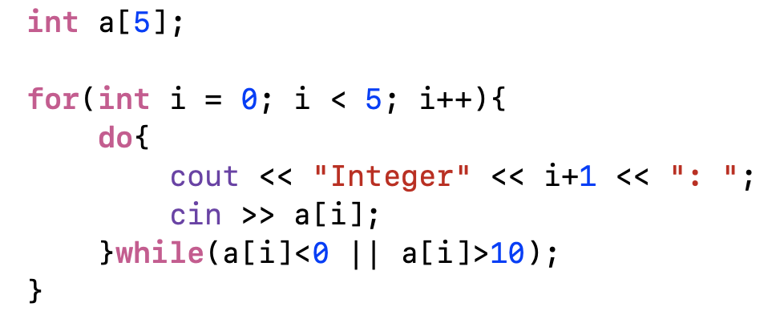
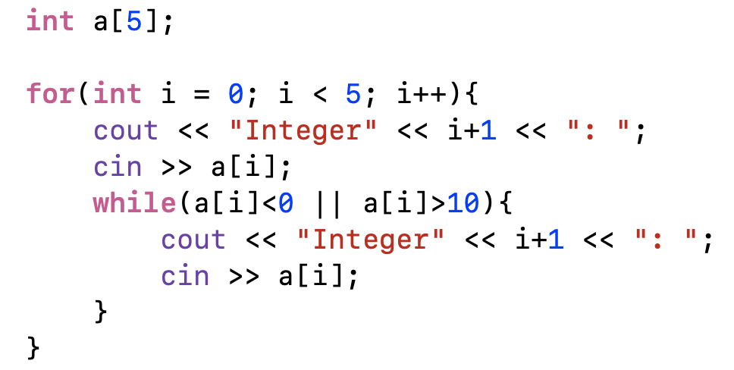
do-while
注意：陣列索引值是從0開始！！！
0
1
2
3
4
a
while

Slide 3
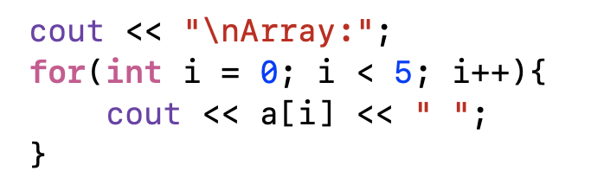
0
1
2
3
4
a
7
1
6
3
8
a[0] = 7, a[1] = 1, a[2] = 6, a[3] = 3, a[4] = 8

Slide 4
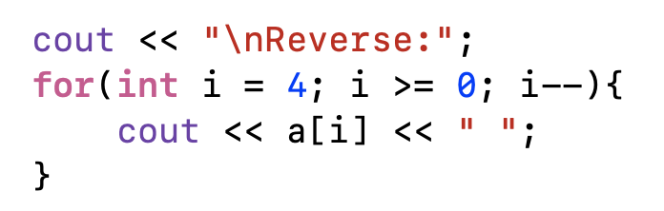
0
1
2
3
4
a
7
1
6
3
8
a[4] = 8, a[3] = 3, a[2] = 6, a[1] = 1, a[0] = 7

Slide 5
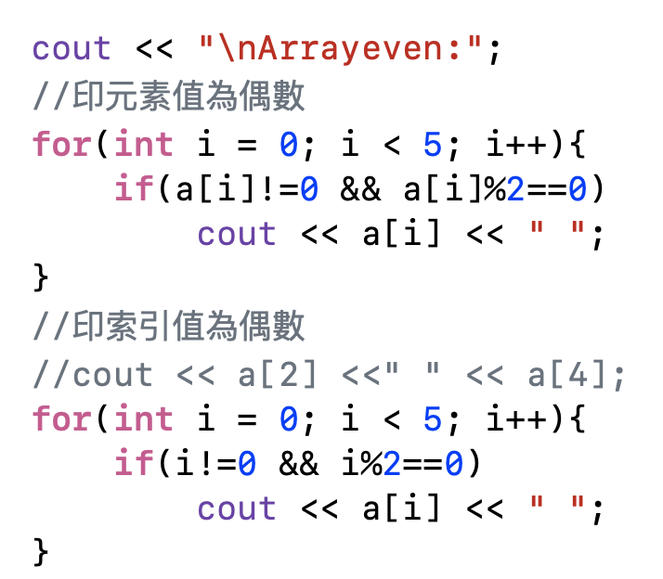
0
1
2
3
4
a
7
1
6
3
8

Slide 6
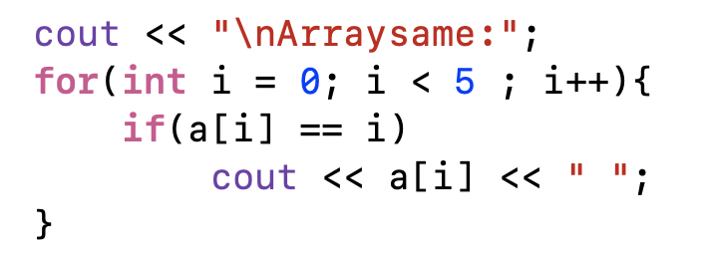
0
1
2
3
4
a
7
1
6
3
8

Slide 7
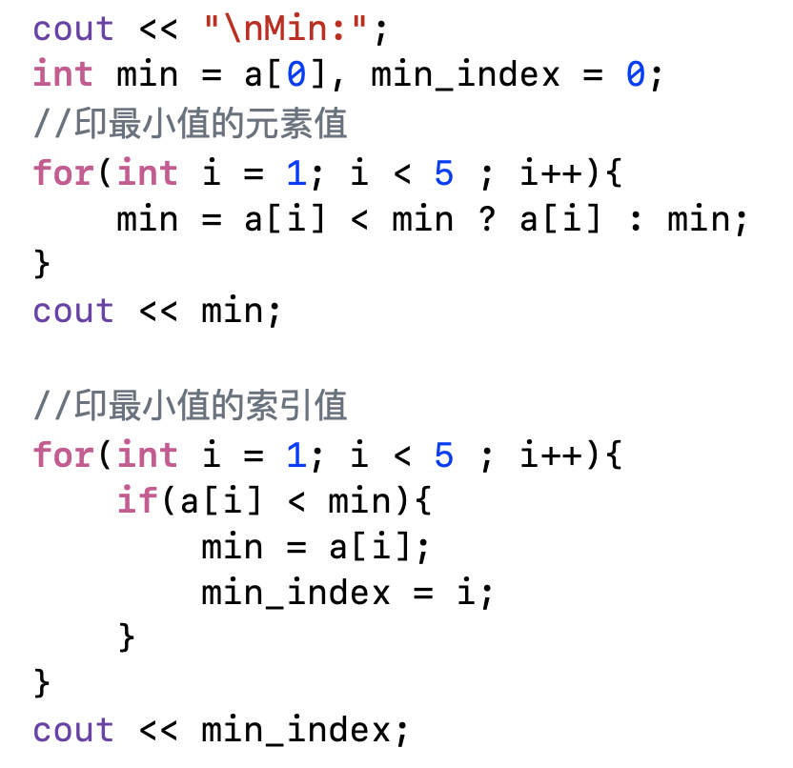
0
1
2
3
4
a
7
1
6
3
8

Slide 8
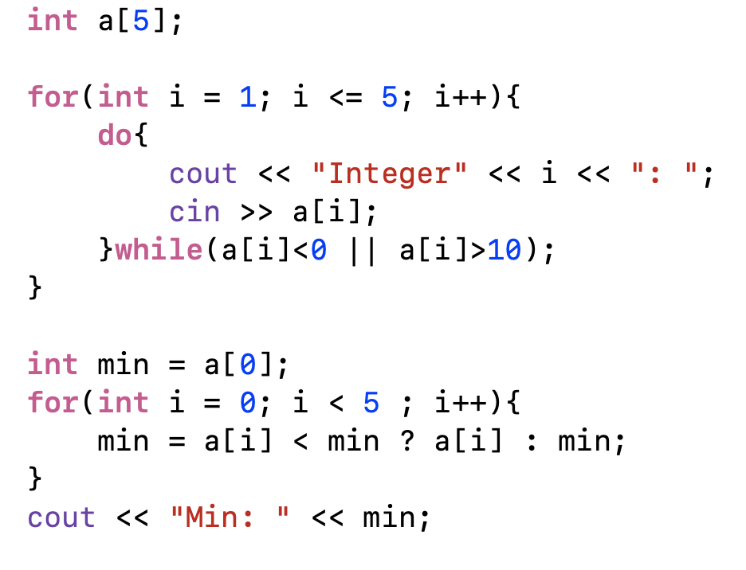
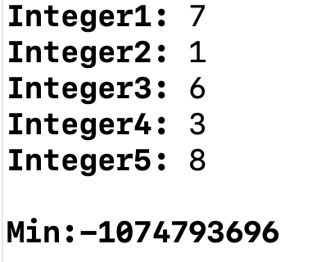
1
2
3
4
5
1
a
7
1
6
3
8
a[0]

